Slide 1
Selection Sort and Merge Sort
Katharine
BE in Computer Science and Engineering

Slide 2
Introduction
Sorting algorithms are fundamental in computer science.
They help in organizing data efficiently for searching, indexing and optimizing storage.

Slide 3
Selection Sort: Introduction
Definition: The Selection Sort algorithm finds the lowest value in an array and moves it to the front of the array.
Comparison based In-place sorting algorithm

Slide 4
Selection Sort: Algorithm
1. Go through the array to find the lowest value.
2. Move the lowest value to the front of the unsorted part of the array.
3. Go through the array again as many times as there are values in the array.

Slide 5
Trace:
Pass 1:
min(64, 25, 12, 22, 11) → 11 is the smallest.
Swap 11 with 64. -> 11, 25, 12, 22, 64
Pass 2:
Find the minimum in (25, 12, 22, 64) → 12 is the smallest.
Swap 12 with 25. -> 11,12,25,22,64
Pass 3:
Find the minimum in (25, 22, 64) → 22 is the smallest.
Swap 22 with 25. -> 11,12,22,25,64
Pass 4:
Find the minimum in (25, 64) → 25 is already in place.
No swap needed. -> 11,12,22,25,64
Pass 5:
Only 64 remains, already sorted.

Slide 6
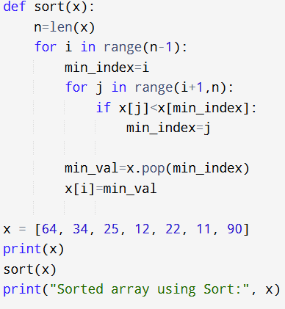
Code :

Slide 7
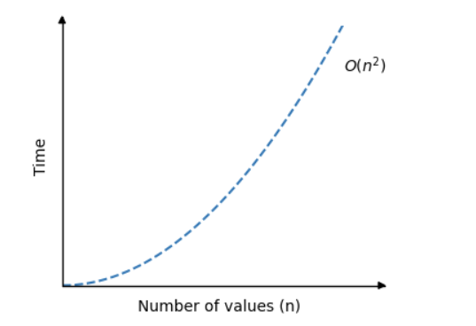
Time Complexity

Slide 8
Advantages and Disadvantages
Advantages Works well for small Data Sets Simple to implement In-Place sorting algorithm
Disadvantages
More comparisons than sorting
Inefficient for Large Data Sets

Slide 9
Merge Sort: Introduction
Definition: Merge Sort is a divide-and-conquer sorting algorithm. It splits the list, sorts each part, and merges them back together
Divide and Conquer methodology

Slide 10
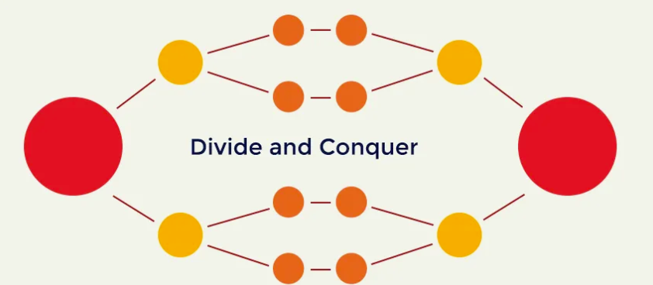
Merge Sort: Algorithm
1. Divide the list into two halves.
2. Recursively split until each part has one element.
3. Merge the sub-lists back in order.

Slide 11
Trace:
1. Divide: [38, 27, 43, 3, 9, 82, 10]
- Left: [38, 27, 43] Right: [3, 9, 82, 10]
2. Divide Left: [38, 27, 43]
- Left: [38] Right: [27, 43]
- Divide Right: [27, 43] → Left: [27], Right: [43]
- Conquer & Combine: [27, 43] → Merge: [27, 38, 43]
3. Divide Right: [3, 9, 82, 10]
- Left: [3, 9], Right: [82, 10]
- Divide: [3, 9] → Left: [3], Right: [9] → Merge: [3, 9]
- Divide: [82, 10] → Left: [82], Right: [10] → Merge: [10, 82]
4. Combine: Merge [3, 9] and [10, 82] → [3, 9, 10, 82]
5. Final Merge: [27, 38, 43] and [3, 9, 10, 82] → Sorted: [3, 9, 10, 27, 38, 43, 82]

Slide 12
def merge_sort(arr):
if len(arr) > 1:
mid = len(arr) // 2 # Middle
left_half = arr[:mid]
right_half = arr[mid:]
merge_sort(left_half) # Recursively sort left half
merge_sort(right_half) # Recursively sort right half
i = j = k = 0 # Merge the sorted halves
while i < len(left_half) and j < len(right_half):
if left_half[i] < right_half[j]:
arr[k] = left_half[i]
i += 1
else:
arr[k] = right_half[j]
j += 1
k += 1
Code :

Slide 13
Code :
# Copy rem ele of left_half, if any
while i < len(left_half):
arr[k] = left_half[i]
i += 1
k += 1
# Copy rem ele of right_half, if any
while j < len(right_half):
arr[k] = right_half[j]
j += 1
k += 1
# Example I/O:
arr = [64, 34, 25, 12, 22, 11, 90]
merge_sort(arr)
print("Sorted array using Merge Sort:", arr)

Slide 14
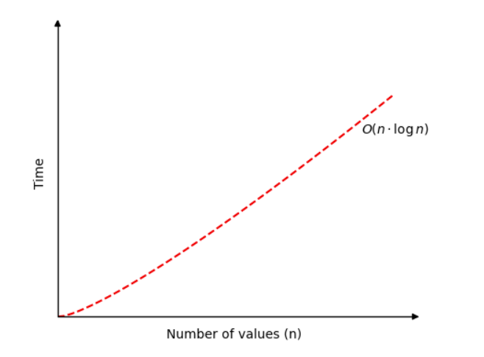
Time Complexity

Slide 15
Advantages and Disadvantages
Advantages Guaranteed worst-case performance Simple to implement Naturally Parallel
Disadvantages
Space complexity
Not in-place

Slide 16
Thank You

